Slide 1
INFORMATION SESSION
Liberal Studies
Human Services Cohort Model - ACA/NY and LifePlan CCO

Slide 2
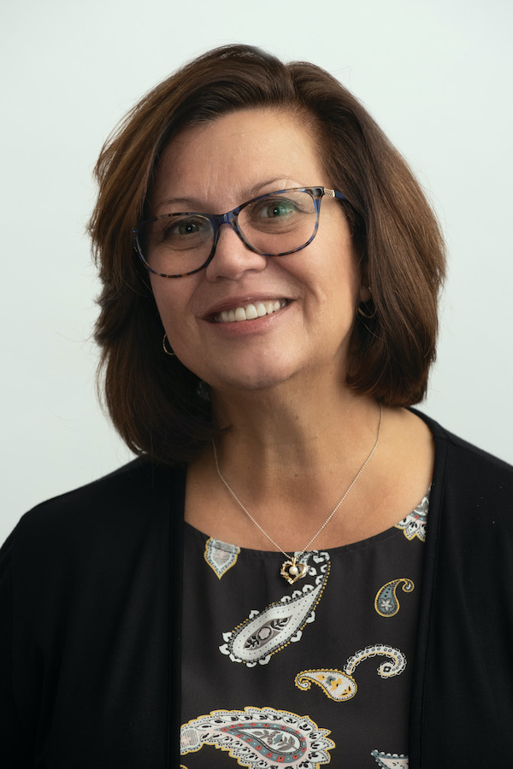
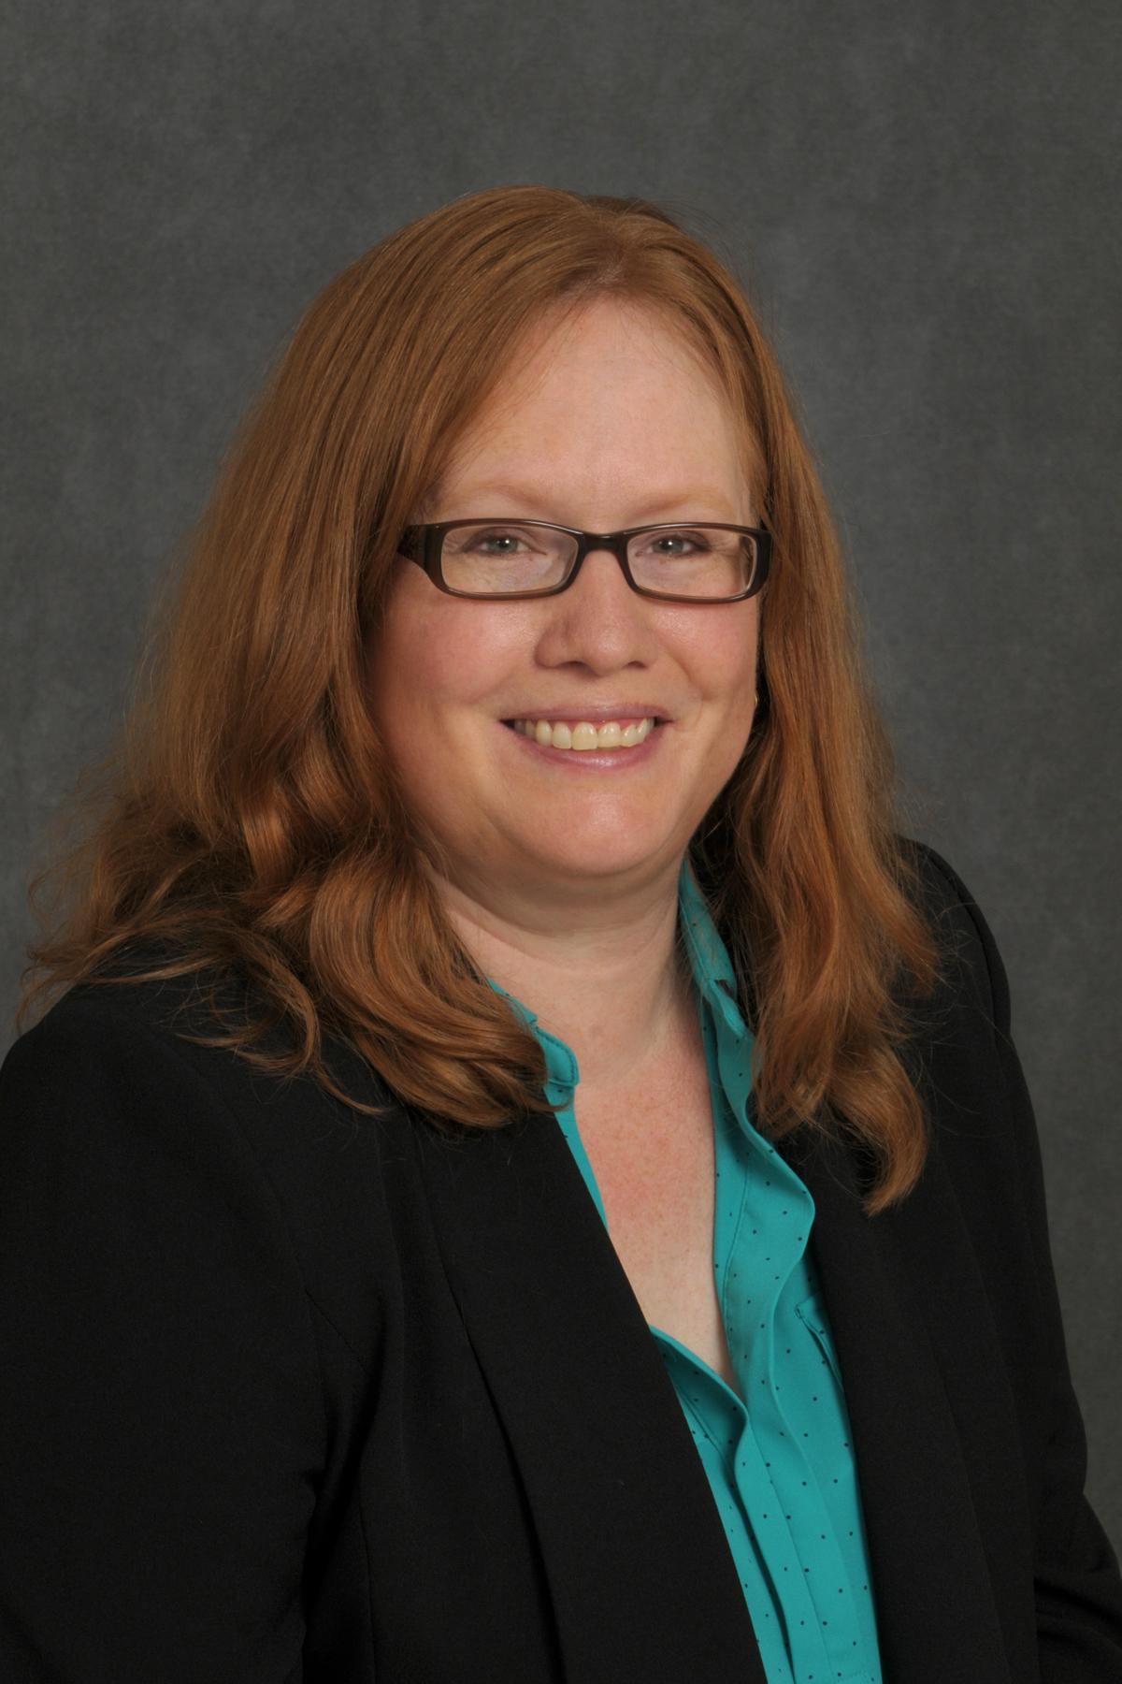
WELCOME
Carolyn Jankowski Assistant Dean
Director, Human Services Cohorts Program
Elisa Scott Faculty Director

Slide 3
ABOUT STONY BROOK UNIVERSITY
3

Slide 4
COHORT PROGRAM OVERVIEW

Slide 5
Cohort Program Overview
What is a cohort?
Cohort programs are created through a contract with the Agency and Stony Brook University. “Learn where you earn.”
Agency cohort students take the same course with each other every term.
The course of study is planned out to allow one course per term with four courses per calendar year. The program will be completed in 2.5 years. Traditional graduate students have five years to complete their SPD degree if not part of a cohort.
All course offerings are scheduled in 10-week terms.
The cohort coursework is approved by the agency per a contractual agreement with Stony Brook University.
5

Slide 6
COHORT PROGRAM
COSTS AND PAYMENTS
A traditional student pays $1758.49 for a 3-credit graduate course at SUNY’s affordable tuition rate.
Stony Brook University has approved a Human Services Agency Cohort Program cost for a 3-credit graduate course to be: $ 1214.60!!*
Cohort Program payments are to be made to the agency directly.
For more information and forms, refer to the Off-campus Cohort Student Information webpage: https://www.stonybrook.edu/commcms/spd/off-campus-cohorts/students.php

Slide 7
COHORT PROGRAM ENROLLMENT
Students will be automatically enrolled each term by the School of Professional Development’s (SPD) Records and Admissions Office.
Students are responsible to check their schedules on SOLAR each term.
Leave of Absence:
Students who need to take a leave of absence must submit a signed Leave of Absence/Leave of Cohort form 2 weeks prior to the start of any term and inform their agency contact person and their faculty director.
Students who miss a class will need to make up the class outside of the cohort (regular tuition rates apply).

Slide 8
Program Features
No GRE required
Certain on-campus fees waived - value of approximately $300
$100 Application fee waived with Off Campus Cohort Programs
SBU human services scholarship - $200 per course
Non-traditional part-time student supports
SBU student status and student benefits
SBU/Human Services Cohort program cost value = savings
Employee/Student Benefits
Agency endorsement and support – eligible for agency tuition reimbursement
Cohort Model – networking with peers and a sense of community
Transfer of knowledge to workplace improves skills and best practices
PROGRAM FEATURES
8

Slide 9
Program
Overview
9

Slide 10
Master of Arts in Liberal Studies
with a Concentration in Human Services
Liberal Studies Core Courses: 15 credits (4 Liberal Studies Foundation (LSF) courses + 1 STEAM course)
Human Services Concentration: 15 credits (5 courses)
Capstone Project Seminar: 3 credits (one course)
_______________________________________
Total for program: 33 credits (11 courses)
Certain courses in the MA in Liberal Studies program are currently not offered elsewhere – only through cohort programs.

Slide 11
LSF 501 Effective Professional Communication
LSF 502 Effective Professional Thinking
LSF 503 Effective Professional Global and Social Awareness
LSF 504 Effective Professional Action and Leadership
STEAM elective – any course with the NSLS designator or approved substitution
MASTER’S
DEGREE
Liberal Studies Core

Slide 12
LSF 501
Effective Professional Communication
All cohort students will begin the program with LSF 501 - Professional Communication.
As part of this class, students will complete 2 library seminars on research and citation skills.
Knowing how to conduct research and properly cite others’ work are crucial skills
for success in any graduate program.

Slide 13
CEL 596 Leadership Theory and Practice
CEL 597 Leading High-Performance Teams
CEL 537 Foundations of the Non-Profit Organization
CEL 538 Financial Accounting for Non-Profit Organizations
CEL 536 Advocacy and Legislation
Other course options: CEZ 545 Autism Spectrum Disorders Today, CEF 562 Transition Planning for People with Intellectual/Developmental Disabilities, etc.
Liberal Studies Concentration
Sample Human Services
Program– 15 credits

Slide 14
MASTER’S
DEGREE
Capstone Seminar
Teaches students to understand and conduct research. Typically requires a 20-25 page research paper but instructors may permit some alternative submissions
Must earn a “B” or higher to count toward the degree
Students will be guided in selecting a topic for their research based on their concentration

Slide 15
Online classes begin on Monday and end on Sunday evenings starting with the first day of the term.
Most courses are offered as fully asynchronous online classes but some instructors may offer some synchronous elements.
10-week terms (usually 10 consecutive weeks)
Terms: Fall, Spring I and Spring II and Summer
SCHEDULING OVERVIEW
15

Slide 16
One 3-credit course per session
Fall 2023 3 credits
Spring I 2024 3 credits
Spring II 2024 3 credits
Summer 2024 3 credits
Fall 2024 3 credits
Spring 1 2025 3 credits
Spring 2 2025 3 credits
Summer 2025 3 credits
Fall 2025 3 credits
Spring I 2026 3 credits
Spring II 2026 3 credits
Degree Program Schedule for Completion in 2.5 Years
16

Slide 17
ADMISSIONS

Slide 18
ADMISSIONS REQUIREMENTS
Requirement | Domestic Students
Bachelor’s degree (3.0 GPA* verified with official transcripts)
Resume
Personal Statement
Letter of Good Standing from Sponsoring Agency
GRE | Not required!
* Conditional admission is possible for students who have GPAs that are under 3.0.

Slide 19
Next Steps
Order an official transcript
Send electronic transcripts to: spd_transcripts @stonybrook.edu
Send hard copy transcripts to: Graduate Program Director
Computer Science Room 2321 Stony Brook, NY 11794-4434
International transcripts require a WES evaluation – www.wes.org
TOEFL scores not required if English is your 1st or 2nd Language
Start to prepare your personal statement
Update your resume
When you apply, you must choose to apply as a Human Services cohort applicant. Look for the name of your agency.
19

Slide 20
Application Timeline
Application link:
https://professionaldevelopment.stonybrook.edu/apply/
Applications due by July 15, 2023
Decisions and offers 4-6 weeks after submission
IMPORTANT - You must accept offer of Admission upon receipt
Fall 2023 semester starts - September 18, 2023
Students will be enrolled 2 weeks prior to the start of the term
Payment arrangements will be worked out with your agency
20

Slide 21
Advisement and Assistance
Program Directors/Coordinators:
MA in Liberal Studies
Elisa Scott, J.D.
Director of MA in Liberal Studies
Elisa.scott@stonybrook.edu
Program Email: spd_liberalstudies@stonybrook.edu
Human Services Cohort Programs
Carolyn Jankowski, Assistant Dean Director of Human Services Programs
Carolyn.jankowski@stonybrook.edu
SPD Records and Admissions: spd@stonybrook.edu
631.632.7050
General Off-Campus Cohort Information Website:
https://www.stonybrook.edu/commcms/spd/off-campus-cohorts/students
21

Slide 22
QUESTIONS?

Slide 23
THANK YOU!

